Slide 1
DNSC 6330 · Responsible Machine Learning · George Washington University
Group 2
A Responsible AI Audit · 2024 HMDA Mortgage Data
PRESENTED BY
Natchapa Aunkay (Gift)
Tatenda Kagande
Hazel Mugadza
Oliastic Ngoshi
Shreyas Kuradagi
Steven Chu

Slide 2
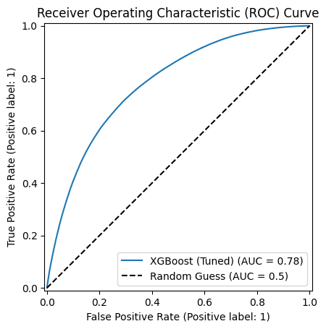
Q1: Optimization Objective
Optimization Objective: ROC-AUC with Threshold = 0.7
Objective
Maximize ROC-AUC to ensure strong ranking performance between approved (1) and denied (0) mortgage applications
Use decision threshold = 0.7 for final classification
Key Insight
Significant improvement in ranking ability (AUC)
Smaller gain in threshold-based performance (F1) → Indicates non-linear relationships captured by XGBoost

Slide 3
Why AUC + Why Threshold = 0.7?
Why ROC-AUC?
Measures model performance across all thresholds, not just one
Captures global ranking quality, critical in lending decisions
More robust than accuracy under class imbalance
Aligns with regulatory expectations:
Evaluates whether the model systematically separates groups before thresholding
From results: +0.1163 AUC gain shows strong improvement in predictive ordering
Why Threshold = 0.7?
Conservative cutoff → reduces false approvals (risk exposure)
Aligns with risk-sensitive lending policy
Moves decision boundary to favor precision over recall
Reflects business need:
Cost of approving a bad loan > denying a good loan
Trade-off
Higher threshold →
↓ False positives (good for lender risk)
↑ False negatives (potential fairness concern)

Slide 4
Q2: Known Failure Modes
Where does the model break down — and who is harmed when it does?
◈ SHAP
◉ SHAP
◆ DiCE
◇ PSI
Global & Local Importance
Waterfall Explanations
Counterfactual Analysis
Feature Drift Testing
Failure Mode 1 → Proxy Bias
Failure Mode 2 → Risk Override
Failure Mode 3 → Recourse Failure
Failure Mode 4 → Feature Drift
Notes:
Now I’ll discuss Question 2, which focuses on known failure modes in our HMDA mortgage approval model.
Our goal was to identify where the model breaks down, why it fails, and which groups are harmed when these failures occur.
To analyze this, we used four main techniques:
SHAP for global and local feature importance,
waterfall explanations for individual decisions,
DiCE counterfactual analysis,
and PSI with stress testing for feature drift.
From this analysis, we identified four major failure modes: proxy bias, risk override, recourse failure, and feature drift.

Slide 5
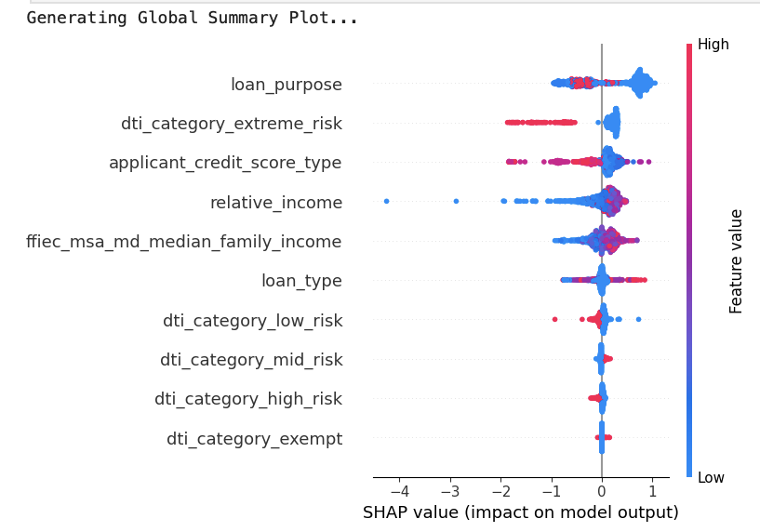
MODE 01
Evidence from Our SHAP Analysis
Top Features by Mean |SHAP| Value
Proxy Discrimination via Neighborhood Income
ffiec_msa_md_median_family_income
0.92
relative_income
0.78
WHAT HAPPENS
0.71
loan_purpose
debt_to_income_ratio
The model uses ffiec_msa_md_median_family_income, which is the median income of the applicant's census tract, as an input feature. Because of residential segregation, this penalizes applicants for where they live rather than their personal financial profile.
0.44
loan_amount
0.31
▲ Proxy features flagged in red — SHAP shows these drive predictions across most applicants
WHO IS HARMED
African-American applicants, who are disproportionately and systemically located in lower-income census tracts due to historical redlining. Race never enters the model explicitly but it enters through the zip code.
SEVERITY: HIGH
Potential ECOA violation
Notes:
Our first failure mode is something we're calling proxy discrimination, and it's the one with the most serious legal implications.
Here's the issue. Our model uses the median income of the applicant's neighborhood as one of its inputs. That sounds reasonable on the surface -- neighborhood income seems like a legitimate financial signal. But when we dug into the data, we found something troubling.
We used a method called SHAP, which essentially asks: for this specific applicant, what factors pushed the model toward approving or denying them? And what we found is that the same neighborhood income feature was pushing African-American applicants toward denial while pushing Caucasian applicants toward approval. This is due to something called residential segregation. For most of the 20th century, Black Americans were systematically blocked from building wealth through homeownership. Banks refused to give mortgages in Black neighborhoods, a practice called redlining. The federal government then backed loans for white families moving to the suburbs while explicitly excluding Black families. Entire generations were locked out of the primary way most American families accumulate wealth.
The result is that today, neighborhood income and neighborhood demographics are deeply correlated not by coincidence, but by policy. Our model never looks at race directly. However, it looks at zip codes. But due to that correlation we mentioned earlier, zip codes carry a lot more implications, so when the model penalizes someone for living in a lower-income neighborhood, it is -- without knowing it -- penalizing them for the consequences of discrimination their parents and grandparents faced. That's what we mean by proxy discrimination. The bias doesn't need to be intentional to cause real harm, and under fair lending law, that distinction doesn't matter.
We flagged this as high severity.
—-------------
This first failure mode is proxy discrimination through neighborhood income.
The model heavily relies on features like FFIEC median family income, relative income, and loan purpose. SHAP analysis showed these were among the most influential features in the model.
The issue is that FFIEC median family income represents the income level of the applicant’s census tract, not the individual applicant directly. Because residential segregation and historical redlining patterns still exist, the model may indirectly learn racial and socioeconomic patterns even though race itself is not included.
As a result, applicants from historically disadvantaged neighborhoods may be penalized simply because of where they live rather than their true financial risk.
This especially harms African-American applicants, who are disproportionately represented in lower-income census tracts.
We classified this as a high-severity fairness risk and a potential ECOA compliance concern

Slide 6
MODE 02
SEVERITY: HIGH
Risk Override · DTI Bypass
SHAP WATERFALL · CAUCASIAN APPLICANT
High-risk case approved via feature trade-off
SHAP · Local (Waterfall)
Base value E[f(x)]
−0.001
loan_purpose
+0.84
WHAT FAILS
dti_extreme_risk
−0.72
Non-critical features override fundamental financial risk signals. A high-risk applicant with extreme DTI can still be approved.
ffiec_msa_income
−0.35
loan_type
+0.32
WHY IT FAILS
No hard constraints on financial risk signals. The model treats all features as independently tradeable — loan purpose can cancel out a dangerous DTI.
relative_income
+0.19
applicant_credit_score
+0.13
f(x) = 0.417 → APPROVED
WHO IS HARMED
Minority applicants receive inconsistent approvals; the fair lending system produces unreliable, legally indefensible decisions.
⚠ loan_purpose (+0.84) overrides extreme DTI risk (−0.72) → net APPROVED
Notes:
Our second failure mode is a little more technical, but the plain English version is this: the model can be talked out of a red flag.
Debt-to-income ratio is one of the most basic measures of whether someone can afford a loan. If your monthly debt payments eat up most of your income, that's a serious warning sign. Our model knows this. It correctly penalizes high DTI.
But we found cases where another feature, loan purpose, was strong enough to completely cancel that penalty out. So you could have an applicant the model itself has flagged as extreme financial risk, and they still get approved because of why they want the loan.
That's a problem. There's no floor, no hard limit that says 'regardless of everything else, extreme DTI means denial.' Every feature is tradeable against every other feature, which means the model's safety signals aren't actually safe.
And just to flag briefly, that neighborhood income feature from failure mode one shows up here too, which tells us this isn't an isolated issue. These patterns are connected.
The bottom line for this one is that the institution could be approving genuinely high-risk applicants, and when those loans go bad, there's no clear explanation for why they were approved in the first place. That's a legal and financial liability.
—---------------
This second failure mode shows that non-critical features can override fundamental financial risk signals.
In the SHAP waterfall explanation, we found a high-risk applicant with extreme debt-to-income risk still received an approval prediction.
The waterfall plot shows that loan purpose contributed a strong positive SHAP value of plus 0.84, while extreme DTI risk only contributed minus 0.72.
Because the positive contribution was larger, the final prediction became approved.
This reveals that the model treats features as independently tradeable rather than enforcing hard financial constraints. In other words, loan purpose can effectively cancel out dangerous financial risk.
This creates inconsistent approvals and can especially harm minority applicants because similar financial risk profiles may receive different outcomes depending on feature interactions.
We considered this a high-severity reliability and fairness issue.

Slide 7
Recourse Failure (Counterfactuals)
MODE 03
SEVERITY: MED-HIGH
DiCE · Counterfactual
WHAT FAILS
DiCE Counterfactual Output · Example Case
The model generates counterfactual recourse suggestions that are mathematically valid but completely unrealistic for real applicants to act on.
Feature | Original | Suggested | Feasible?
credit_score | 620 | 1,028 | ✗ No
relative_income | 0.24 | 14.3 | ✗ No
loan_purpose | refinance | home_improv. | ~ Maybe
WHY IT FAILS
No real-world constraints enforced. Assumes all features are independent and freely adjustable — ignores causal structure and human limits.
WHO IS HARMED
Rejected applicants — especially disadvantaged groups — receive guidance they cannot follow, denying them meaningful recourse.
Key Insight: DiCE found no feasible counterfactuals. Every valid flip required changes beyond human reach — exposing that the model provides no real recourse to rejected applicants.
Notes:
This third failure mode focuses on counterfactual explanations using DiCE.
We tested whether rejected applicants could realistically improve their outcomes. However, the model generated recommendations that were mathematically valid but unrealistic in practice.
For example, one counterfactual required increasing the applicant’s credit score from 620 to over 1,000 and increasing relative income from 0.24 to 14.3.
These values are not feasible in the real world the maximum for credit score is 850.
This happens because the model assumes all features are freely adjustable and independent, while ignoring causal and human constraints.
As a result, rejected applicants receive guidance they cannot realistically follow, meaning the model fails to provide meaningful recourse.
This issue disproportionately affects disadvantaged applicants and was classified as medium-to-high severity.

Slide 8
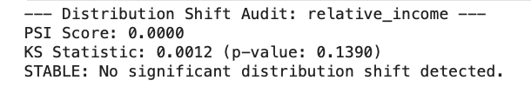
Feature Drift (relative_income)
MODE 04
SEVERITY: MED - HIGH
PSI + KS Test + Stress Testing
WHAT FAILS
Drift Testing Results
The model assumes input distributions stay stable, but economic shocks can shift key features post-2024. Subgroup drift may not appear in global metrics.
PSI (global)
KS Test p-value
≈ 0.0000
0.139
WHY IT FAILS
No global drift
Not significant
• Global PSI ≈ 0.00 → masks subgroup-level drift
• KS test p = 0.139 → no global difference
• But 15% income shock → accuracy drops ~1.3%
Stress Test (−15% income)
Subgroup Risk
−1.3%
Hidden
Accuracy drop
Global masks local
WHO IS HARMED
Borderline applicants near the decision threshold and minority groups — more sensitive to income distribution shifts — face disproportionate impact.
Key Insight: Global stability metrics can hide subgroup drift. Even small income distribution shifts disproportionately impact borderline and minority applicants.
Notes:
This final failure mode examines feature drift using PSI, KS testing, and stress testing.
At the global level, PSI was approximately zero and the KS test was not statistically significant, which initially suggests the model is stable over time.
However, when we simulated a 15 percent income shock, model accuracy dropped by around 1.3 percent.
This shows that even when global drift metrics appear stable, subgroup-level risks may still exist.
Borderline applicants and minority groups are especially vulnerable because small changes in income distributions can push them across the decision boundary.
The key insight is that global stability metrics may hide local fairness risks, especially during economic changes or shocks.
We classified this as medium-to-high severity.

Slide 9
Q2 Summary · Failure Mode Table
Failure Type | Trigger Condition | Harmed Group | Method | Severity
Proxy Bias | Model uses FFIEC income & loan_purpose as racial proxies | African-American applicants | SHAP (global) | HIGH
Risk Override | Loan purpose SHAP value overrides extreme DTI risk signal | Minority applicants | SHAP (waterfall) | HIGH
Recourse Failure | DiCE counterfactuals require unrealistic changes (score >1000, income 40–60×) | Rejected applicants | DiCE | MED–HIGH
Feature Drift | 15% income shift post-2024 drops accuracy & hits borderline cases | Borderline / minority applicants | PSI + KS + Stress | MED–HIGH
Notes:
To summarize, we identified four major failure modes in the HMDA mortgage approval model.
First, proxy bias occurs because geographic and socioeconomic variables act as indirect racial proxies.
Second, risk override shows that loan purpose can outweigh extreme financial risk, producing inconsistent approvals.
Third, the counterfactual analysis revealed that the model provides unrealistic recommendations that applicants cannot practically follow.
Finally, feature drift analysis showed that even small economic shifts can disproportionately affect borderline and minority applicants, despite stable global metrics.
Overall, the model performs well statistically, but important risks remain in fairness, consistency, robustness, and real-world usability.

Slide 10
Q3: Subgroup Error Measurement
How Subgroup Errors Were Measured? How Errors Were Measured Across Subgroups?
◉ Metrics computed
◆ Groups examined
Accuracy and AUC
Race
FPR and FNR
Gender
AIR, ME and SMD
Race + Gender

Slide 11
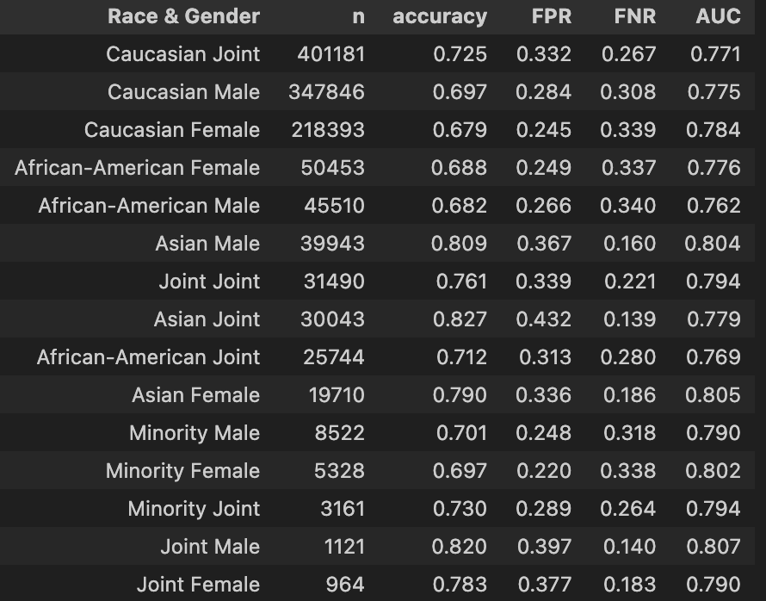
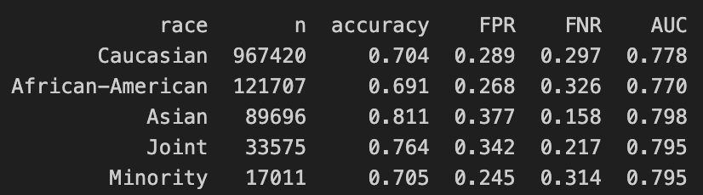
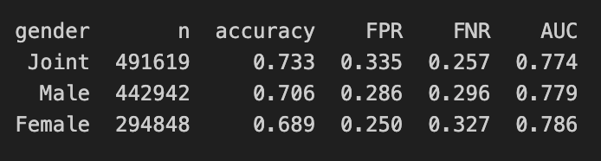
Q3: How Subgroup Errors Were Measured
Disparity Metrics were applied to the 2024 HMDA dataset to measure how the model treated each racial group
Strategic Actions & Opportunity Cost
Threshold Optimization & Fairness Constraints
Proxy Variable De-biasing
Regulatory Compliance & Intergenerational Wealth

Slide 12
Q3: How Subgroup Errors Were Measured
SUBGROUP ERROR RESULTS · BY RACE
2024 HMDA Data — Caucasian as reference baseline
AIR = Rate ÷ Ref ME = Rate − Ref SMD = (μ_group − μ_ref) ÷ Pooled SD
Disparity Metrics were applied to the 2024 HMDA dataset to measure how the model treated each racial group
GROUP
RATE
AIR
ME
SMD
① MEASURING THE APPROVAL GAP (AIR)
African-American
0.716
0.854
−0.123
0.001
How: Each group's approval rate was divided by the Caucasian approval rate the reference baseline under EEOC fair lending guidelines. What the model showed: The model approved African-American applicants at 0.716 vs. 0.839 for Caucasians, producing an AIR of 0.854. The model clears the legal 0.80 threshold but still applies a 14.6% lower approval rate to this group.
Minority
0.719
0.856
−0.121
0.008
Caucasian
0.839
1.000
0.000
—
② MEASURING THE SCALE OF HARM (ME)
How: The Caucasian approval rate was subtracted from each group's rate because AIR as a ratio conceals how many people the model's decisions actually affect. What the model showed: The model produced an African-American ME of −0.123. Across 607,746 African-American applicants in this dataset, that gap represents tens of thousands of additional denials.
Asian
0.858
1.022
+0.018
0.004
⚡ KEY TAKEAWAY
AIR revealed the model's approval gap. ME exposed the real-world scale of the model's decisions. SMD confirmed this feature was not the source the model's bias originates elsewhere.
③ TRACING THE ERROR SOURCE (SMD)
How: SMD (Group Mean − Caucasian Mean) ÷ Pooled SD was computed for each feature to test whether the model was using it as a racial proxy. What the model showed: The model scored relative_income at SMD 0.001–0.008 across all groups (negligible). This feature is not the source; the model's bias enters through interactions with other variables.
SMD INTERPRETATION
< 0.2 No proxy effect 0.2–0.5 Mild 0.5–0.8 Moderate > 0.8 Strong proxy → investigate

Slide 13
Q3:How Errors Were Measured Across Subgroups
SUBGROUP ERROR MEASUREMENTS · RACE × GENDER
Sorted by AIR ascending — lowest = model's largest error
SUBGROUP
RATE
AIR
ME
The dataset was split by Race × Gender to measure how the model's decisions varied across intersectional groups
Minority Female
0.698
0.854
−0.120
① THE DATA WAS SPLIT INTO SUBGROUP CELLS
Afr.-Amer. Male
0.706
0.863
−0.112
How: Every applicant in the dataset was grouped by their Race × Gender combination. Cells with n < 30 were excluded to ensure the model's patterns were statistically reliable. Baseline: Caucasian Male the industry-standard reference under EEOC fair lending guidelines. The model's AIR and ME for every other cell was measured against this group.
Afr.-Amer. Female
0.709
0.867
−0.109
Minority Male
0.715
0.874
−0.103
② AIR & ME RAN ON EACH CELL SEPARATELY
How: The same AIR and ME formulas were applied but the model's outputs were computed per intersectional cell, not per race alone. What the model showed: The model produced Minority Female AIR 0.854 , ME −0.120. Legally compliant yet the model's decisions result in ≈3,200 minority women denied due to this gap.
Caucasian Female
0.813
0.994
−0.005
Caucasian Male (ref)
0.818
1.000
0.000
③ CELLS RANKED TO SIZE THE MODEL'S WORST ERROR
Asian Male
0.849
1.038
+0.031
How: All cells were sorted by AIR ascending. The lowest AIR identifies the subgroup the model penalises most. What the model showed: Minority Female ranked worst (AIR 0.854). Critically, the model scored an African-American Joint application two incomes lower than a solo Caucasian Male, revealing that the model discounts the co-borrower's risk benefit when both applicants are minority.
⚡ KEY TAKEAWAY
Race-only AIR masked the model's worst decisions. The Race × Gender split is what exposed Minority Female as the group the model penalises most invisible in any single-variable view.

Slide 14
Q4: Residual Risks
& Deployment Defensibility
What risks remain after mitigation and is deployment defensible?
⚠ AIR Metric
Blindness
📊 Historical Bias
Amplification
🔒 Non-Recourse
& Privacy Gaps
Metric masking post-attack
Training data structural gaps
Boundary rigidity · Outlier risk
Risk 1 → AIR Metric Blindness
Risk 3 → Non-Recourse & Privacy Gaps
Risk 2 → Historical Bias Amplification
Q5 → Deployment: Conditionally Defensible

Slide 15
RISK 01
Poisoning Attack: Accuracy vs. AIR
SEVERITY: HIGH
AIR Metric
Blindness
25% label-flip targeting African-American cohort
−0.5%
−0.008
Accuracy Drop (global)
AIR Shift (post-attack)
Poisoning Audit · FPR/FNR
0.8136 → 0.8082
0.9460 → 0.9387
WHAT FAILS
ABOVE 0.80
COLLAPSED
Even after a 25% label-flipping attack on African-American applicants, AIR stayed above 0.80, appearing legally compliant while minority-cohort accuracy silently collapsed.
AIR vs. Threshold
Minority Cohort Accuracy
WHY IT FAILS
Appears compliant
Hidden by global avg
AIR measures relative approval volumes, not predictive correctness. An attacker can destroy group-level accuracy without ever moving the ratio.
Key Insight: AIR is blind to targeted adversarial attacks. Global metrics must be replaced by per-group FPR/FNR dashboards — a monitoring gap that persists post-mitigation.
WHO IS HARMED
African-American applicants: accurately qualified applicants are denied and unqualified ones approved, but global metrics hide this completely.

Slide 16
RISK 02
Fairness Audit · Intersectional Results
SEVERITY: HIGH
Historical Bias
Amplification
Race × Gender subgroup performance — post-mitigation snapshot
Subgroup
AIR
Status
African-American
0.946
PASS
African-American · Male
0.941
PASS
Training Data · SHAP · AIR
African-American · Female
0.952
PASS
WHAT FAILS
Minority (aggregate)
0.938
PASS
XGBoost trained on 2024 HMDA data inherits structural racial composition imbalances from decades of discriminatory lending. An applicant in a historically redlined zip code faces a harder boundary despite equal financial credentials.
Caucasian (baseline)
1.000
—
Unmitigated Gap: Fairness constraints were studied but never applied. The model remains in production without reweighting, resampling, or Exponentiated Gradient mitigation.
WHY IT FAILS
Reweighting and fairness constraints were evaluated during the audit but never applied to the production model. The bias is learned, then silently scaled at inference time.
Key Insight: All intersectional cohorts pass the 4/5ths AIR threshold, but AIR compliance does not mean the bias is gone. Historical imbalances are encoded into the model's decision boundary and will systematically disadvantage minority applicants in underserved geographies.
WHO IS HARMED
Minority applicants in lower-income MSA census tracts, the model penalizes geography, not personal risk.

Slide 17
RISK 03
Security & Privacy Audit Results
SEVERITY: MED–HIGH
Non-Recourse
& Privacy Gaps
Evasion attacks + Membership Inference — combined findings
FAILED
FAILED
HopSkipJump Attack
Boundary Attack
Model boundary not breached
Absolute boundary rigidity
HopSkipJump · Boundary Attack · MIA
0.0000
EXPOSED
WHAT FAILS
The model's sharp XGBoost boundary means applicants near the 0.51 threshold cannot be told which actions will flip their outcome. DiCE counterfactuals require a credit score >1,000 and income 40–60× above current, humanly impossible.
Privacy Leakage Score
Outlier Vulnerability
No systemic memorisation
Attribute inference not audited
WHY IT FAILS
DiCE Counterfactual · Recourse Table
No monotonicity constraints enforced. All features are freely tradeable in the model, but not in real life. The boundary is secure from adversarial attacks but offers no actionable path for rejected consumers.
Feature
Original
Suggested
Feasible?
credit_score
620
>1,028
✗ No
WHO IS HARMED
Marginal applicants, disproportionately minority, and outlier individuals whose unique financial profile could expose them to attribute-inference privacy attacks not caught by aggregate metrics.
relative_income
0.24
14.3×
✗ No
loan_purpose
refinance
home_improv.
~ Maybe

Slide 18
Q5: Is Deployment Defensible?
NIST AI RMF · EU AI Act · Three Lines
PRE-CONDITIONS FOR GO-LIVE
WHAT PASSES
Deploy per-group FPR/FNR dashboards with automated alerts before first live inference — replace AIR-only monitoring.
1
All intersectional subgroup audits (Race × Gender) cleared the 4/5ths AIR threshold. HopSkipJump and Boundary adversarial attacks both failed to penetrate the model — confirming evasion resistance.
2
Implement cryptographic batch hashing and anomaly detection on label distributions in the training pipeline.
GOVERNANCE MET
Complete Leave-One-Out influence analysis on high-leverage applicants before external API access is granted.
Architecture satisfies EU AI Act High-Risk requirements: risk management, data governance, transparency, human oversight. NIST AI RMF GOVERN, MAP, MEASURE, and MANAGE pillars are all addressed.
3
4
Run Differentially Private XGBoost experiment; document ε budget and accept/reject based on AUC–fairness tradeoff.
HITL SAFEGUARD
5
Retrain with income/DTI monotone constraints so marginal applicants receive actionable recourse paths.
Marginal applicants (p ≈ 0.51) are automatically flagged for human review. Autonomous harm is structurally bounded — no fully autonomous high-stakes decisions.

Slide 19
Q4 & Q5 Summary · Risk & Deployment Table
Risk / Check
Trigger Condition
Harmed Group
Method
Status
AIR Metric Blindness
25% label-flip attack — AIR stays >0.80 masking minority cohort collapse
African-American applicants
Poisoning Audit
HIGH
Historical Bias Amplif.
FFIEC census-tract income encodes redlining into feature space
Minority / MSA applicants
SHAP + AIR
HIGH
Non-Recourse Rigidity
DiCE needs score >1,000 & income 40–60× — no feasible recourse path
Rejected applicants
DiCE + HopSkipJump
MED–HIGH
Outlier Privacy Gap
Attribute inference not audited; Leave-One-Out analysis pending
Outlier applicants
MIA (rule-based)
MED–HIGH
EU AI Act Conformity
High-Risk classification met; HITL, transparency & oversight satisfied
Regulatory compliance
Framework audit
PASS
Deployment Defensible?
4 pre-conditions must close before production go-live
All applicants
NIST AI RMF
CONDITIONAL

Slide 20
DNSC 6330 · Responsible Machine Learning · George Washington University
THANK YOU
PRESENTED BY
Natchapa Aunkay (Gift)
Tatenda Kagande
Hazel Mugadza
Oliastic Ngoshi
Shreyas Kuradagi
Steven Chu

